Slide 1


INVESTOR UPDATE · AUGUST 2026
CHAKHANA
Humara Snacks. Chakha Na?
A FAST-MOVING SNACKING BRAND
Prepared for the Chakhana investor group
01

Slide 2
THE POSITIONING
CHAKHANA
Better-for-you, never boring.
Live today at chakhanasnacks.com — makhana chips made for cravings that refuse to be boring.
Flavour-First
Makhana, Seasoned Properly
Built for the 4pm Slump
Pairs with Everything
Masaledar, chatpata, never bland — every flavour is built to crave, not just tolerate.
Real fox nut, seasoned generously — a better-for-you snack that doesn't taste like one.
Resealable pouches, ready whenever the craving hits — not an occasion snack.
Goes great with food, and especially special with drinks.
02

Slide 3
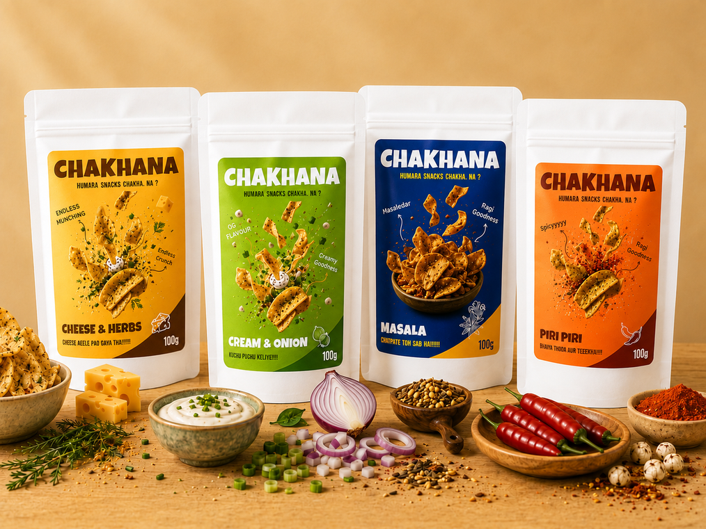
THE PRODUCT
CHAKHANA
Four makhana flavours, live and shipping today.
Masala, Peri Peri, Cream & Onion, Cheese & Herbs — seasoned properly, in 50g and 100g resealable pouches.
Masala
OG FLAVOUR
“Chatpate toh sab hai!!!”
Peri Peri
BESTSELLER
“Bhaiya thoda aur teeekha!!!!”
Cream & Onion
“Kuchu Puchu Keliye!!!!”
Cheese & Herbs
BESTSELLER
“Cheese aeele pao gaya tha!!!!!”
6 flavours across makhana & ragi · 50g / 100g pack sizes · Sampler pack available · Pan-India shipping
CHAKHANA · INVESTOR UPDATE
03

Slide 4
SNAPSHOT
CHAKHANA
Chakhana, at a glance.
₹32,525
69%
315
₹30K
₹0
Total revenue
Gross margin
Units sold
B2B revenue · 2 deals
Marketing spend
THE STORY IN ONE PARAGRAPH
We sold through our first batch entirely on organic pull — zero paid marketing, two B2B deals worth ₹30K, and a 69% gross margin that holds even at small scale. The next phase is about turning that pull into a repeatable channel mix: hometown retail in Hyderabad and Pune, flea retail in Bengaluru starting 22nd August, and a stall-led initiative to lift average order value. ₹40K of fresh inventory is underway, projected to convert into ₹1.5L of revenue.
CHAKHANA · INVESTOR UPDATE
04

Slide 5
I · TRACTION
CHAKHANA
Zero paid marketing. Full sell-through.
₹32,525
total revenue, from a standing start
2 deals
315 units
₹10.9K
B2B closed — ₹5K + ₹25K = ₹30K
sold, across channels
gross profit to date
The number is not the story. Where it came from is.
CHAKHANA · INVESTOR UPDATE
05

Slide 6
I · TRACTION
CHAKHANA
₹0
spent on marketing or flea stalls — and the batch still sold out
Customers bought after tasting, not after reading an ad
Not one flea stall has been paid for yet
Preorders cleared most of the batch before launch day
That's the signal we're building the growth plan around.
CHAKHANA · INVESTOR UPDATE
06

Slide 7
II · UNIT ECONOMICS
CHAKHANA
69% margin holds on every pack.
Line | % of Selling Price
Selling price (100g) | 179
Landed cost (incl. transport) | 45
Packaging | 10
Total COGS | 31%
gross margin
69%
total COGS share
31%
COGS · 31%
GROSS PROFIT · 69%
Landed cost and packaging together are just 31% of selling price — margin holds even before scale kicks in.
CHAKHANA · INVESTOR UPDATE
07

Slide 8
IV · THE GROWTH PLAN
CHAKHANA
Four moves, one goal: turn organic pull into a repeatable channel mix.
1
2
3
4
Hometown Sales
Flea Retail
AOV Initiative
Inventory Bet
Hyderabad and Pune — home turf first.
Bengaluru fleas, starting 22nd August.
Chaat stall + inserts to lift order value.
₹40K stock → ~₹1.5L projected revenue.
CHAKHANA · INVESTOR UPDATE
09

Slide 9
IV · THE GROWTH PLAN
CHAKHANA
Home turf first, then the street.
HOMETOWN SALES
FLEA RETAIL
Hyderabad + Pune
Bengaluru
Selling direct where trust and word-of-mouth already work in our favour — the fastest lane to repeat orders.
Taste-before-you-buy footfall, impulse purchase, live trial — without a rupee of ad spend.
WHY WE WAITED
WHY NOW
We wanted the high inventory and pack proven on trust before renting floor space.
Preorders cleared most of the batch — a bigger inventory drop is what unlocks the next stall.
First flea: 22nd August, Bengaluru.
CHAKHANA · INVESTOR UPDATE
10

Slide 10
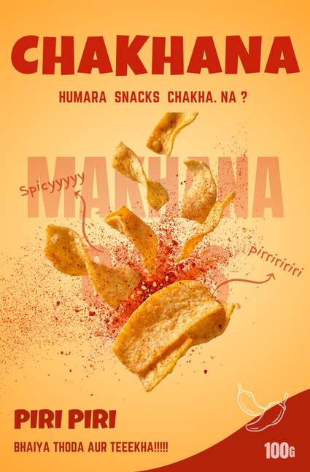
IV · THE GROWTH PLAN
CHAKHANA
AOV Initiative — the Makhana Chaat Stall.
The same trick that made Dorito bhel a hit, run on Chakhana instead.
The Fit
Chips folded into a chaat everyone already knows — turns a snack break into an activity.
The Placement
A Chakhana bhel corner at every flea table and hometown pop-up, sold on the spot.
The Status
In planning — targeted to launch alongside the first Bengaluru flea, 22nd August.
HOW IT COMPOUNDS
Taste at the stall → buy a pack → QR insert in the pack → return for the next flea.
CHAKHANA · INVESTOR UPDATE
11

Slide 11
V · FINANCIAL OUTLOOK
CHAKHANA
₹40K in stock converts to ₹1.5L in sales.
Already a third of the way there — before the flea and stall channels are even live.
₹35K done
₹1.5L target
₹40K
₹1.5L
₹35K
inventory investment
projected revenue
already realized
One job for the next few weeks: move stock through three channels at once.
CHAKHANA · INVESTOR UPDATE
12

Slide 12
It's early. The sell-through says the model works.
“Humara Snacks. Chakha Na?”
Playful. Desi. Loud. Honest. Every pack, post and pop-up should sound like it.

